Slide 1
Relative Valuation
Dr. Sarveshwar Kumar Inani
(Ph.D., IIM Lucknow)

Slide 2
Agenda
Key steps in relative valuation
Equity Valuation Multiples
Enterprise Valuation Multiples
Operational Multiples
Best Practices Using Multiples
Relative vs DCF Valuation
Market Transaction Method
Practice with Live data (Screener.in)

Slide 3
Relative Valuation
Relative Valuation is a method used to estimate the value of a company (listed or unlisted) by comparing it to similar companies in the same industry.
This approach involves analyzing financial metrics like price-to-earnings (P/E) ratios, price-to-book (P/B) ratios, and enterprise value-to-EBITDA (EV/EBITDA) ratios.
In DCF valuation, an asset is valued on the basis of its cash flow, growth, and risk characteristics. In relative valuation, an asset is valued on the basis of how similar assets are currently priced in the market. Economic logic tell us that similar assets should sell at similar prices.
Relative valuation is mostly used as a supplement with the DCF valuation. However, it is an independent method to identify the valuation of the company.

Slide 4
Key steps in relative valuation
Analyze the Subject Company: To begin with, an in-depth analysis of the competitive and financial position of the subject company (the company to be valued) must be conducted (Product portfolio and market segments covered by the firm, Availability and cost of inputs Technological and production capability, Market image, distribution reach, and customer loyalty, Product differentiation and economic cost position, Managerial competence and drive, Quality of human resources, Competitive dynamics, Liquidity, leverage, and access to funds, Turnover, margins, and return on investment).
Select Comparable Companies: After the subject company is studied, the next step is to select companies which are similar to the subject company in terms of the lines of business, nature of markets served, scale of operation, and so on. Finding the right comparable companies is challenging (it required a lot of skills, knowledge, and experience).

Slide 5
Key steps in relative valuation
Choose the Valuation Multiple(s): A number of valuation multiples are used in practice. They may be divided into two broad categories: (a) equity valuation multiples (price-earnings ratio, price-book value ratio, and price-sales ratio), and (b) enterprise valuation multiples (EV-EBITDA ratio, EV-FCFF ratio, EV-book value ratio, and EV-sales ratio).
Calculate the Valuation Multiples for the Comparable Companies: Based on the observed financial attributes and values of the comparable companies, calculate the valuation multiples for them.
Value the Subject Company: Given the observed valuation multiples of the comparable companies, the subject company may be valued. A simple way to do is to apply the average multiples of the comparable companies to the relevant financial attributes of the subject company and obtain several estimates (as many as the number of valuation multiples used) of enterprise value for the subject company and then take their arithmetic average. Another way is to look at the subject company’s growth, risk, size, price multiples of comparable firms and decide the price multiple applicable to subject company (subjective and judgmental value).

Slide 6
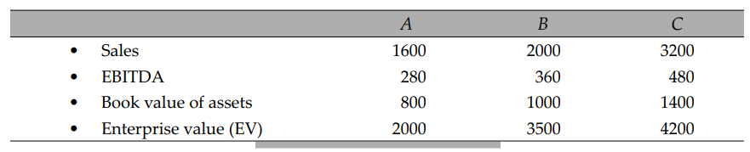
Illustration (Book PC)
The following financial information is available for company D, an unlisted pharmaceutical company, which is being valued.
• EBITDA : 400 million
• Book value of assets : 1,000 million
• Sales : 2,500 million
Based on an evaluation of a number of listed pharmaceutical companies, A, B, and C have been found to be comparable to company D. The financial information for these companies is given below:

Slide 7
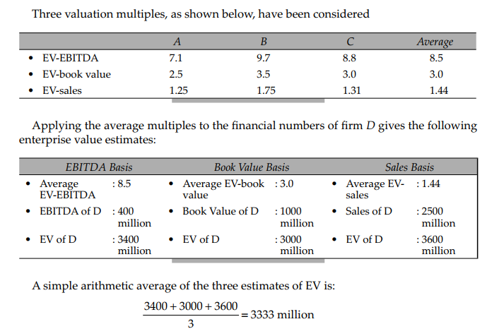
Illustration: Solution (Book PC)
Compute all these ratios
Discuss arithmetic average vs median
Number of firms (5-10)

Slide 8
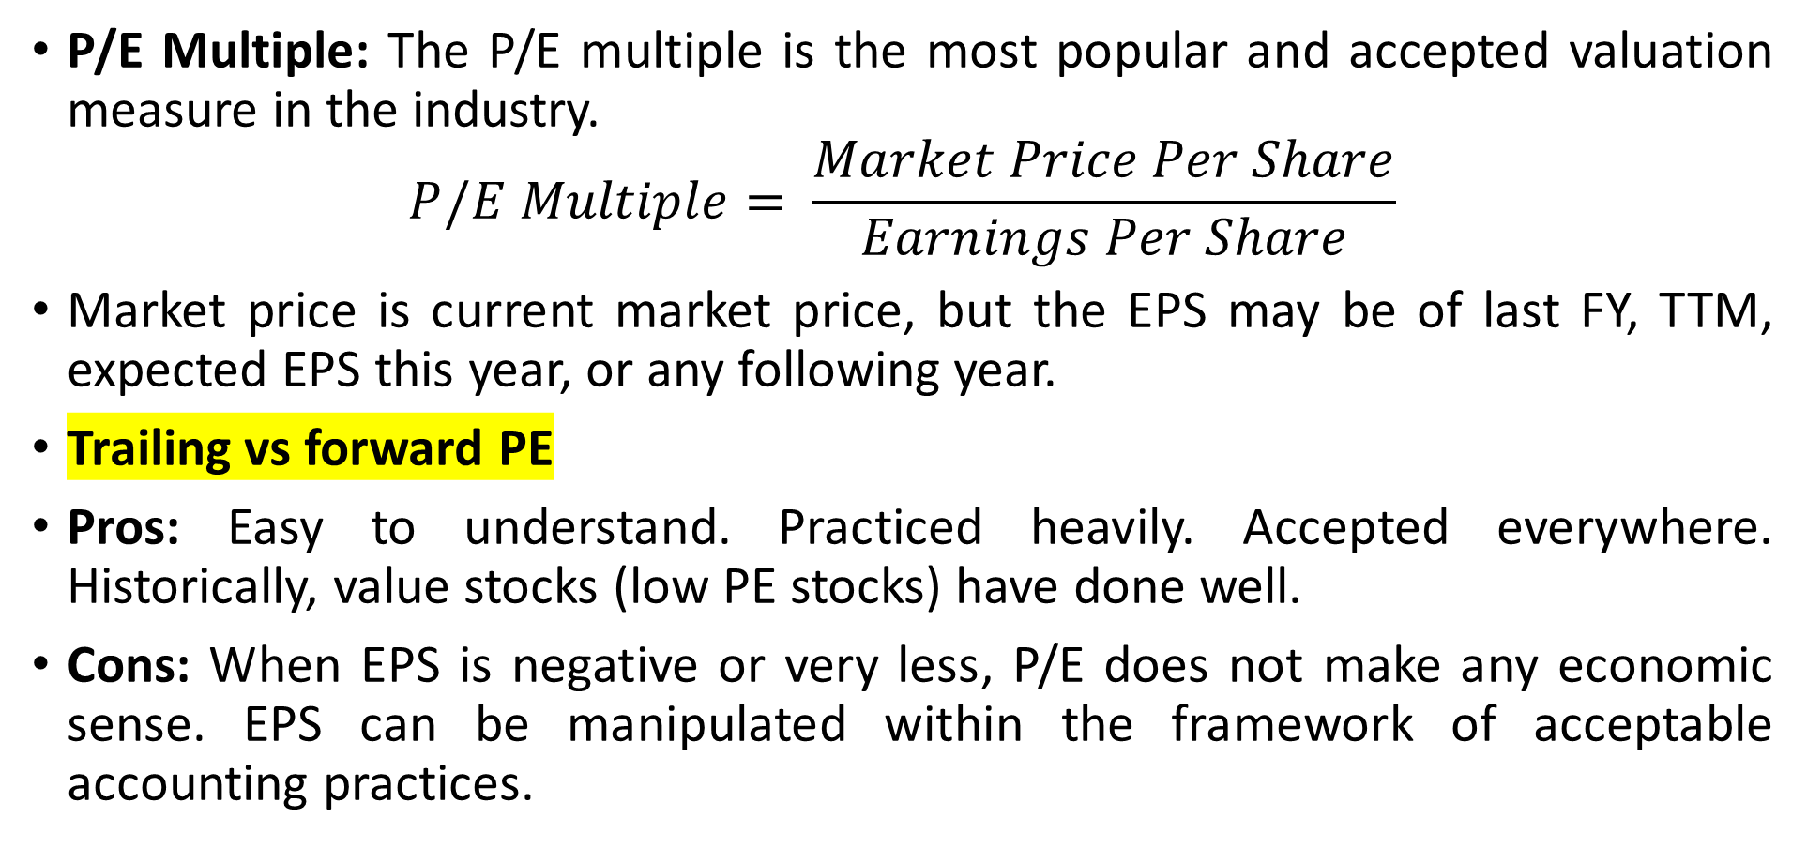
Equity Valuation Multiples
P/E Multiple: The P/E multiple is the most popular and accepted valuation measure in the industry.
$$P/E Multiple= \frac{Market Price Per Share}{Earnings Per Share}$$
Market price is current market price, but the EPS may be of last FY, TTM, expected EPS this year, or any following year.
Trailing vs forward PE
Pros: Easy to understand. Practiced heavily. Accepted everywhere. Historically, value stocks (low PE stocks) have done well.
Cons: When EPS is negative or very less, P/E does not make any economic sense. EPS can be manipulated within the framework of acceptable accounting practices.

Slide 9
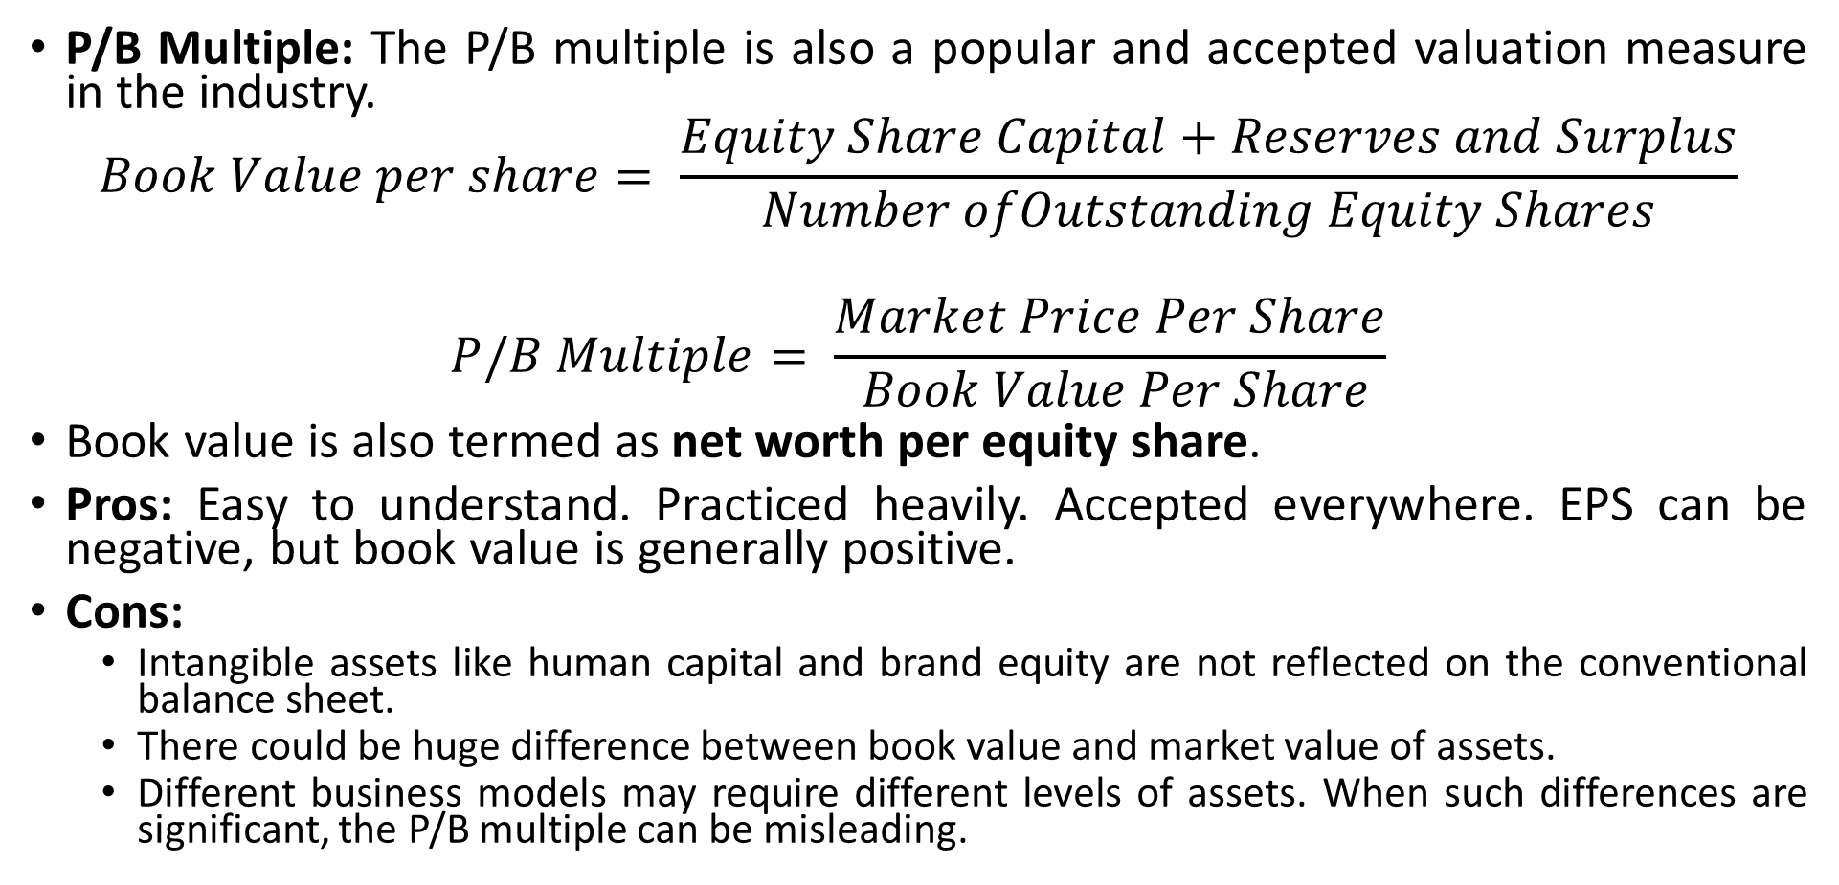
Equity Valuation Multiples
P/B Multiple: The P/B multiple is also a popular and accepted valuation measure in the industry.
$$Book Value per share= \frac{Equity Share Capital+Reserves and Surplus}{Number ofOutstanding Equity Shares}$$
$$P/B Multiple= \frac{Market Price Per Share}{ Book Value Per Share}$$
Book value is also termed as net worth per equity share.
Pros: Easy to understand. Practiced heavily. Accepted everywhere. EPS can be negative, but book value is generally positive.
Cons:
Intangible assets like human capital and brand equity are not reflected on the conventional balance sheet.
There could be huge difference between book value and market value of assets.
Different business models may require different levels of assets. When such differences are significant, the P/B multiple can be misleading.

Slide 10
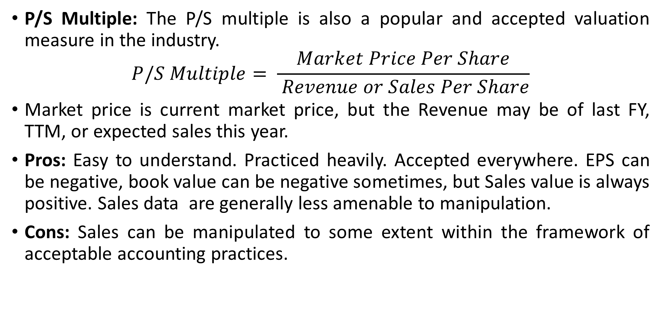
Equity Valuation Multiples
P/S Multiple: The P/S multiple is also a popular and accepted valuation measure in the industry.
$$P/S Multiple= \frac{Market Price Per Share}{ Revenue or Sales Per Share}$$
Market price is current market price, but the Revenue may be of last FY, TTM, or expected sales this year.
Pros: Easy to understand. Practiced heavily. Accepted everywhere. EPS can be negative, book value can be negative sometimes, but Sales value is always positive. Sales data are generally less amenable to manipulation.
Cons: Sales can be manipulated to some extent within the framework of acceptable accounting practices.

Slide 11
Enterprise Valuation Multiples
While equity multiples focus on the value of equity, enterprise value multiples focus on the value of the enterprise (firm). The enterprise value is usually related to some measure of earnings, assets, or sales. The commonly used enterprise value multiples are:
• EV/EBITDA multiple
• EV/EBIT multiple
• EV/FCFF multiple
• EV/BV multiple
• EV/Sales multiple

Slide 12
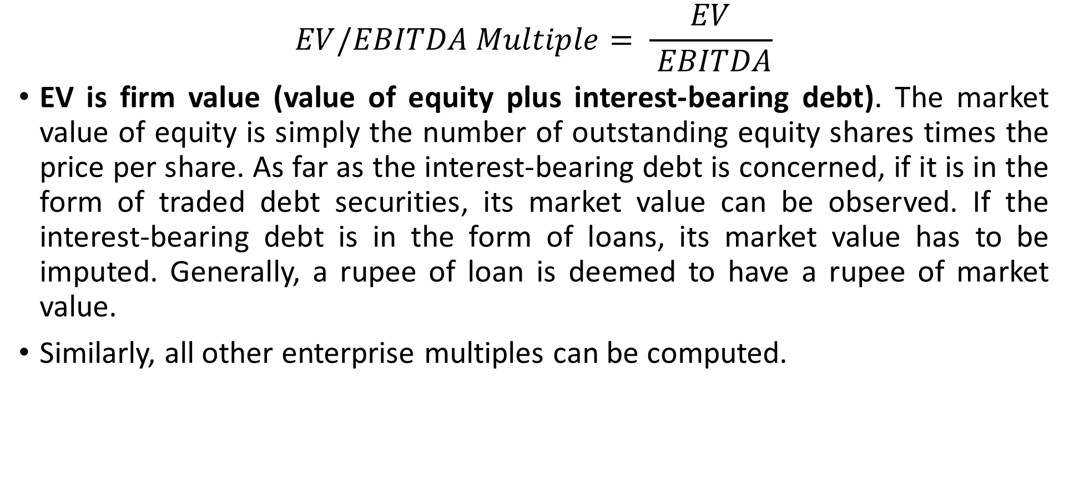
EV/EBITDA Multiple
$$EV/EBITDA Multiple= \frac{EV}{ EBITDA}$$
EV is firm value (value of equity plus interest-bearing debt). The market value of equity is simply the number of outstanding equity shares times the price per share. As far as the interest-bearing debt is concerned, if it is in the form of traded debt securities, its market value can be observed. If the interest-bearing debt is in the form of loans, its market value has to be imputed. Generally, a rupee of loan is deemed to have a rupee of market value.
Similarly, all other enterprise multiples can be computed.

Slide 13
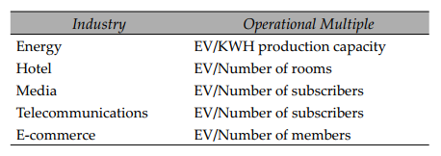
Operational Multiples
An operational multiple expresses the enterprise value (EV) in relation to a specific operational variable, which is usually a key driver of revenue or cash flow. Some examples of operational multiples from different industries are shown below:

Slide 14
Choice of Multiple
Since different multiples produce different values, the choice of multiple can make a big difference to your value estimate. Which multiple should you use?
The Cynical View: You can choose a multiple that serves a preconceived notion. If you want to sell (buy) a business, choose the multiple that gives the highest (lowest) value. While this may appear like manipulation and not analysis, it seems to be a fairly common practice.
The Bludgeon View (Combine many methods): You can value a company using a number of multiples and then arrive at a final recommendation. There are three ways of doing this:
Generate a range of values and decide the valuation.
Compute a simple average of the various values by the different multiples. It is simple but it assigns equal weight to the values from each multiple, even though some multiples may be more appropriate than others.
So, you can calculate a weighted average (the weight assigned to each value reflecting its relative precision).

Slide 15
Choice of Multiple…
The Best Multiple: Using the one multiple that is most appropriate for the firm being valued. Three methods:
The fundamental approach: Use the variable that has the highest correlation with the firm’s value.
The statistical approach: Use regression and use the multiple with the highest R-squared.
The conventional approach: Using the multiple that has become the most commonly used one for a specific situation or sector. Here are some suggestions in this regard:
• The P/E multiple is more appropriate for firms that have (a) a proven track record of positive earnings, and (b) no significant non cash expenses.
• The P/B multiple is more appropriate for firms whose balance sheets reflect reasonably well the market value of their assets. Examples: banks and financial institutions.
• The EV/EBITDA multiple is more suitable for firms that have substantial noncash expenses (depreciation and amortisation). Examples: capital intensive firms like airliners, telecom operators, refineries.
• The EV/FCFF multiple is more appropriate for firms that have stable growth and predictable capital expenditures.
• The EV/Sales multiple makes sense for young firms that have not yet established positive earnings.

Slide 16
Best Practices Using Multiples
• Define multiples consistently: measured uniformly across the firms being compared.
• Choose comparable companies with similar profitability and growth prospects.
• Identify the fundamental determinants (highly related with the valuation).
• Use multiples that use forward-looking estimates: Since a company’s value is equal to the present value of its future cash flow, forward-looking multiples are consistent with the theory of valuation. Empirical evidence, too, suggests that forward-looking multiples are better predictors of value.
• Prefer enterprise-value multiples: P/E ratios has shortcomings (Like it is affected by capital structure and non-operating income, which can impact the EPS and overall impact the valuation). Hence. it makes more sense to use the Enterprise Value-EBITDA ratio. This ratio is less amenable to manipulation by changes in capital structure because enterprise value includes both equity and debt and EBIDTA is the profit available to all investors.

Slide 17
Why Is Relative Valuation so Popular?
Despite the convincing logic underlying the DCF approach to valuation, why are earnings multiples commonly used in equity research reports and investment banking pitches?
While discounted cash flow valuation is commonly done as part of acquisition analysis, the value paid is usually determined or justified in terms of some multiple(s).
A DCF valuation requires projections about ROIC, growth, and free cash flow. Since predicting the future is a difficult task requiring subjective forecasts, analysts find it convenient to use earnings multiples.
The primary advantage of the relative valuation method is that it employs market-based values and is not driven by assumptions like the discounted cash flow method.

Slide 18
Weaknesses of Relative Valuation
As the underlying assumptions of relative valuation are not explicitly defined, it provides the analyst greater scope for manipulation.
The multiples used in the relative valuation approach reflect the valuation errors (over-valuation or under-valuation) of the market. Thus, if so ware companies in general are over-valued applying the average price-earnings multiple of listed so ware companies to determine the value of an unlisted company may lead to over-valuation.
In contrast, the DCF approach is grounded on firm-specific cash flows and growth rates and hence is likely to be less affected by market valuation errors.

Slide 19
Relative vs DCF Valuation
Different Valuation Estimates: Both discounted cash flow (DCF) and relative valuation can produce varying value estimates for a company.
Market Efficiency Assumption: The key difference lies in their underlying assumptions about market efficiency. DCF assumes markets are inefficient, making mistakes that are eventually corrected. Whereas, Relative valuation assumes markets are generally efficient on average, though individual stocks might be mispriced.
Valuation Discrepancies: If comparable firms are undervalued, a target company might be undervalued by relative valuation but overvalued by DCF. The opposite occurs if the comparison firms are overvalued.

Slide 20
Market Transaction Method
A variant of the market comparable method, the market transaction method employs transaction multiples in lieu of trading multiples.
As the name suggests, transaction multiples are the multiples implicit in recent acquisitions/disposals of similar companies.
The primary advantage of this method is that the transaction multiples are based on negotiation between more informed buyers and sellers and hence are less likely to be affected by market inefficiencies.
While using transaction multiples, the following factors should be considered: nature of transaction (friendly or hostile), the prevailing market sentiment at the time of transaction, form of compensation (stock or cash), contingent payments (if any), and so on.

Slide 21
Practice with Live data (Screener.in)
Do valuation of an unlisted IT company, Mukul Limited, having these numbers:
• PAT : 15 crores
• Book value of net assets : 55 crores
• Sales : 100 crores
Number of outstanding equity shares: 10 crores
Choose some comparable companies and compute equity multiples (P/E, P/B, and P/S).
Take simple average or median (to avoid impact of outliers) of multiples.
Compute Value of Equity for Mukul Limited.
Compute value per equity share.
Source: https://www.youtube.com/watch?v=CPtBJN3SAvs&ab_channel=KenjiExplains

